Slide 1
Knowledge-based approach to Winograd Schema Challenge
Knowledge-based approach to Winograd Schema Challenge
Igor Boguslavsky, Tatiana Frolova, Leonid Iomdin, Alexander Lazursky, Ivan Rygaev, Svetlana Timoshenko
Presented by Ivan Rygaev (irygaev@gmail.com)
Laboratory of Computational Linguistics Institute for Information Transmission Problems RAS, Moscow, Russia
Supported by RSF grant No. 16-18-10422-P

Slide 2
Abstract
We propose a method to resolve anaphoric pronouns in the framework of Winograd Schema Challenge (WSC) by means of SemETAP – a knowledge-based semantic analyzer.

Slide 3
Table of contents
Winograd Schema Challenge
Related work
SemETAP semantic analyzer
Our approach to WSC

Slide 4
Table of contents
Winograd Schema Challenge
Related work
SemETAP semantic analyzer
Our approach to WSC

Slide 5
Turing test criticism
Turing Test was formally passed by a chat-bot Eugene Goostman in 2014
But does the chat-bot think?
Is conversation the right way of evaluation?
Subjective
Encourage verbal acrobatics and trickery
Turing Test requires deception
Must fool an interrogator that it is a person
Do we need this from an intelligent machine? For which purposes?

Slide 6
Winograd schemas
A better test was proposed in Levesque 2011
The trophy doesn’t fit in the brown suitcase because it’s too big. What is too big?
the trophy
the suitcase
Joan made sure to thank Susan for all the help she had given. Who had given the help?
Joan
Susan
Terry Winograd provided the first example in 1970

Slide 7
Winograd schema structure
Anaphora resolution problem
There are two potential antecedents in the sentence
Linguistic features, collocation statistics and selectional restrictions do not help much
Changing a special word in the sentence reverts the correct answer (big -> small)
The trophy doesn’t fit in the brown suitcase because it’s too small. What is too small?
the trophy
the suitcase

Slide 8
Commonsense knowledge
People are good on Windograd Schemas
Tests show 91-92% “correct” answers
What is required to get the right answer?
Understanding of the verb ‘fit’
if A fits into B then A must be smaller than B.
Understanding of the connective ‘because’
Changing it to ‘in spite of’ also reverts the answer.
Implicit information must be extracted from the text to pass the test

Slide 9
More examples
The wrong answer need not be logically inconsistent:
Tom threw his bag down to Ray after he reached the top of the stairs. Who reached the top of the stairs?
Tom
Ray
Alternate special word need not be the opposite:
The man couldn't lift his son because he was so weak/heavy. Who was weak/heavy?
the man
the son

Slide 10
Competition
The first competition was held in July 2016 at IJCAI conference in New York
It was organized in two rounds:
Sentences from real texts (children's literature) rather than constructed ones. They exhibited all the properties of WS but did not have an alternative variant.
Actual constructed WSs with an alternative variant
Motivation for two rounds:
Not to reveal WSs to contestants who are not ready yet
Increase relevance of the test by using real examples

Slide 11
Competition
There were 60 questions in the first round and 60 in the second one.
To proceed to the second round a contestant had to score at least 90% correct in the first one.
None of the solutions achieved that score
The second round was not held
The big prize was offered to the team who would achieve at least 90% in both rounds
Three smaller prizes were offered to the top programs achieved at least 65% in the first round

Slide 12
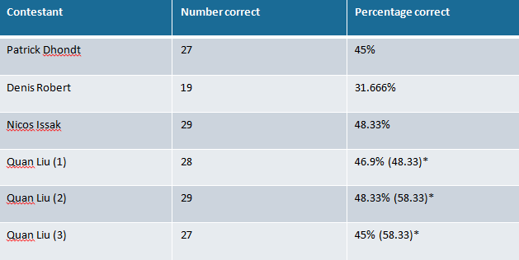
Competition results
Six solutions of four teams where presented:
Random answering could yield 45%

Slide 13
Competition results assessment
None of the solutions got over the 65% threshold to receive even the smaller prize
Four of the six programs showed scores around the chance level or even worse
The next test had been scheduled for AAAI-2018 (Feb), but it was cancelled
Several participants dropped out at the last minute
Text understanding by machines is an unsolved task yet

Slide 14
Table of contents
Winograd Schema Challenge
Related work
SemETAP semantic analyzer
Our approach to WSC

Slide 15
Machine learning
Rahman and Ng 2012
Narrative chains, Google API, FrameNet, heuristic and machine-learned polarity, connective-based relations, etc.
Haoruo Peng et al. 2015
Predicate Schemas learned from the Gigaword corpus, Wikipedia, Web Queries, polarity information, etc.
Quan Liu et al 2016 (competition winner)
Knowledge Enhanced Embeddings (KEE) trained using WordNet, ConceptNet, Cyc, CauseCom
Trinh and Le 2018
Language models trained on big corpora LM-1-Billion, CommonCrawl, SQuAD, Gutenberg Books

Slide 16
Knowledge-based
Schüller 2014
Inferences based on pragmatic effects from Relevance Theory in a graph framework
Bailey et al. 2015
A series of axioms and inference rules for event correlation “A fits into B” <-> “B is big”
Sharma et al. 2015
Knowledge is extracted from the web on demand using a modified test phrase as a pattern. A semantic analyzer is used to match the found sentence with the original one.

Slide 17
Transparency
Eric Mueller 2016:
Computers should be more open and understandable
Computers should provide advice and explain it
People will decide whether to accept it or not
Transparency generates trust and makes fixes easier
Knowledge-based vs machine learning
Knowledge-based approaches have a higher transparency and explanatory power than machine learning techniques
Deep knowledge can hardly be acquired by machine learning (yet)

Slide 18
Table of contents
Winograd Schema Challenge
Related work
SemETAP semantic analyzer
Our approach to WSC

Slide 19
ETAP-4 linguistic processor
Comprehensive support for Russian and English
Syntactic parsing
Building dependency trees
Machine translation
On the level of deep syntactic structures or UNL
UNL conversion and deconversion
Universal Networking Language
Deep semantic analysis
Logical form with inferences

Slide 20
ETAP-4 resources
Combinatorial dictionary
More than 100 000 entries for Russian, English and UNL
Syntactic and semantic features
Government patterns
Lexical functions
Dictionary rules for specific words processing
Transformation rules
For syntactic structure creation and modification
Written in a formal language FORET
Ontology

Slide 21
SemETAP semantic text analyzer
SemETAP (Boguslavsky et al. 2015, 2018)
A module of ETAP-4 linguistic processor
Translates an original sentence into a language-independent semantic representation in a formal language
Applies inference rules (semantic concept decomposition, common sense axioms) to infer new knowledge
Semantic representation
Based on Semantic Web standards (OWL, RDF, SPARQL)
Can be seen as a semantic graph or a formula in predicate logic

Slide 22
SemETAP resources
Linguistic modules and resources
Reused from ETAP-4 itself
Ontology
Repository of individuals
Inference rules
The depth of understanding grows with the number of inferences we can draw from the text
More inferences mean better understanding

Slide 23
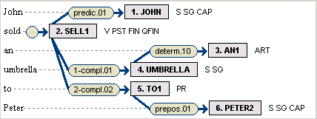
Semantic analysis steps
Syntactic tree
Basic semantic structure
Words are translated to semantic concepts and syntactic relations to semantic roles (roughly)
Enhanced semantic structure
Inference rules are applied to extend the semantic graph

Slide 24
Inference rules
Declarative rules
In the form of implication (if-then)
Written in Etalog formal language (Rygaev 2018)
Datalog± (semantically) compatible language
Requires minimal mathematical background
Syntax made closer to natural language
More than 400 rules at the moment
Most of them are concept decomposition rules
Similar to word definitions in an explanatory dictionary but in a formal language

Slide 25
Event decomposition
Preconditions
Ivan bought a book from Masha -> Masha had had a book
Results
Ivan bought a book from Masha -> Ivan has a book
Subevents
Ivan bought a book from Masha -> Masha gave Ivan a book
Presuppositions
Ivan does not know that Peter arrived -> Peter arrived
Participants objectives & attitudes
Ivan defeated Peter -> Good for Ivan, bad for Peter

Slide 26
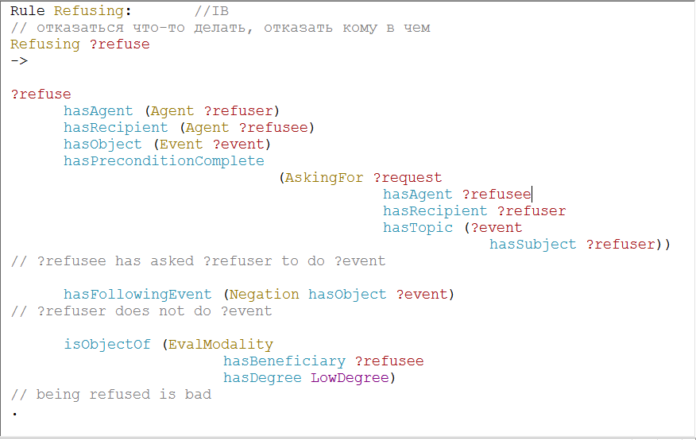
Decomposition rule example

Slide 27
Plausible expectations
Invited inferences (implicatures)
Inferences which are most likely true based on all the information we have so far
John was allowed to smoke -> John smoked (probably)
Marked in the graph with medium degree confidence
Non-monotonic logic
Expectations can be confirmed or cancelled
John was allowed to smoke, but he did not
Made hidden when a corresponding confirming or disproving subgraph of maximal degree exists

Slide 28
Table of contents
Winograd Schema Challenge
Related work
SemETAP semantic analyzer
Our approach to WSC

Slide 29
Semantic consistency
Our approach to WSC
Build two variants of the enhanced semantic structure – one for each potential antecedent
Check which variant is more consistent
Consistency definition
Consistent variant contains the same or unifiable subgraph more than once
Two different parts of the sentence produce the same (unifiable) inference

Slide 30
Example
James asked Robert for a favor but he refused
James asked Robert for a favor but Robert refused
James asked Robert for a favor but James refused
Two events of asking in the enhanced structure
From the first part of the sentence
From the precondition of the refusal event (inferred)
Unification
In the first variant the addressee is the same, other arguments are unifiable
In the second variant the addressees are different

Slide 31
Experimental results
We carried out two series of experiments:
On a development corpus of Winograd schemas
On a test corpus of Winograd schemas
Development corpus
Open WSs phrases translated into Russian
Were open to us while developing the algorithm and populating the knowledge
Test corpus
Phrases were not revealed but the lexicon was known and description for the missing part was added to the system

Slide 32
Development corpus results
Examples:
The perch swallowed the worm, it was hungry/tasty
Peter gave Ivan a candy, because he was (not) hungry
Peter knocked at Ivan’s door, but he didn’t (receive a) reply
Ivan offended Peter so we defended/punished him
Results
In most phrases the antecedents were identified correctly
Explanation is understandable by humans
Conclusion
The algorithm solves WSC if accurate knowledge is given

Slide 33
Test corpus results
Examples:
Peter gave money to Ivan, because he was poor/rich
Peter defeated Kolya because he played well/poorly
John got angry at Bill, although he is kind (was not guilty)
Vasya begged Ivan to stay at home but he refused/failed
Results
Only 54% of antecedents were identified correctly, which is not much but still noticeably more than the random choice
All failures were due to the incomplete knowledge
Conclusion
It is hard to explicate all details without seeing the phrases

Slide 34
Conclusions
A solution to Winograd Schemas was proposed
Based on explicit knowledge stored in the dictionary, ontology and inference rules
Proof of concept: the solution works fine given all the necessary knowledge is presented in the system
Provides human understandable explanations
Limitation:
Time-consuming
It is hard to explicate all necessary knowledge in advance
Computational power is not leveraged
Hybrid approach could be the answer

Slide 35
References
Bailey D., A. Harrison, Yu. Lierler, V. Lifschitz, and J. Michael. (2015), The Winograd schema challenge and reasoning about correlation. In: Working Notes of the Symposium on Logical Formalizations of Commonsense Reasoning.
Boguslavsky I., V. Dikonov, L. Iomdin, A. Lazursky, V. Sizov, S. Timoshenko. (2015), Semantic Analysis and Question Answering: a System Under Development. In: Computational Linguistics and Intellectual Technologies. Papers from the Annual International Conference “Dialogue” (2015), p.62.
Boguslavsky I., Frolova T., Iomdin L., Lazursky A., Rygaev I., Timoshenko S. (2018), Semantic analysis with inference: high spots of the football match. Computational Linguistics and Intellectual Technologies: Proceedings of the International Conference “Dialogue 2018”, Moscow, May 30—June 2.
Haoruo Peng, Daniel Khashabi, and Dan Roth. (2015), Solving hard coreference problems. In: Proceedings of the 2015 Conference of the North American Chapter of the Association for Computational Linguistics: Human Language Technologies, pages 809–819.
Levesque H. (2011), The Winograd Schema Challenge. In: AAAI Spring Symposium: Logical Formalizations of Commonsense Reasoning.
Mueller E. (2016), Transparent Computers: Designing Understandable Intelligent Systems. Createspace Independent Publishers.

Slide 36
References
Quan Liu, Hui Jiang, Zhen-Hua Ling, Xiaodan Zhu, Si Wei, Yu Hu. (2016), Combing Context and Commonsense Knowledge Through Neural Networks for SolvingWinograd Schema Problems. arXiv:1611.04146v1 [cs.AI] 13 Nov 2016.
Rahman A., V. Ng. (2012), Resolving complex cases of definite pronouns: the Winograd schema challenge. In: Proceedings of the 2012 Joint Conference on Empirical Methods in Natural Language Processing and Computational Natural Language Learning, pages 777–789. Association for Computational Linguistics.
Rygaev I. (2018), Etalog - a natural-looking knowledge representation formalism // Proceedings of ITaS 2018 School and Conference (http://itas2018.iitp.ru/media/papers/1570472169.pdf).
Schüller P. (2014), Tackling Winograd schemas by formalizing relevance theory in knowledge graphs. In: Fourteenth International Conference on the Principles of Knowledge Representation and Reasoning.
Sharma A., Nguyen Ha Vo, Somak Aditya, and Chitta Baral. (2015), Towards addressing the Winograd schema challenge-building and using a semantic parser and a knowledge hunting module. In IJCAI, pages 1319–1325.
Trieu H. Trinh, Quoc V. Le. (2018), A Simple Method for Commonsense Reasoning. arXiv:1806.02847v1 [cs.AI] 7 Jun 2018

Slide 37
Thank you for your attention! Questions? Ask now or send an email to irygaev@gmail.com

