Slide 1
Building gapping resolution system overnight: Lessons Learned
MEANOTEK
Denis Tarasov, Tatyana Matveeva, Nailia Galliulina
Denis Tarasov,
Tatyana Matveeva, Nailia Galliulina
Dialogue 2019
international conference on computational linguistics
Email for correspondence: dtarasov@meanotek.io

Slide 2
THE GOAL
Test of NLP rapid model prototyping system on novel type of the task

Slide 3
MOTIVATION
The need to quickly and reliably build NLP models in large quantities for different types of problems
The need for techology to be extensible and improvable

Slide 4
FIRST REQUIREMENT
The need to quickly and reliably build NLP models in large quantities for different types of problems

Slide 5
SECOND REQUIREMENT
The usual way to quickly obtain competive result is to find out current SOTA model, get its code from github, adapt it, if necessary or just train on new data

Slide 6
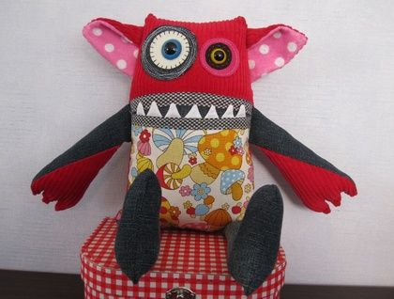
SECOND REQUIREMENT
PROBLEM #1: This leads to unmaintainable software code when combined into complex pipelines

Slide 7
SECOND REQUIREMENT
PROBLEM NUMBER 2:
We cannot improve things that we do not really understand
We don“t really understand things that we can“t duplicate ourselves
Copying someone“s else research puts us in position of forever catching up party

Slide 8
METHODS
Character level context sensetive embeddeings based on language model
Model parameters:
3192*2048*2048 LSTM language model trained on 2.2 GB of text (cleaned common crawl+books dataset) with the goal of predicting next character. Long BPTT length — 350 characters

Slide 9
SIMPLIFICATIONS
Task is considered to be sequence labeling task
Position of V is start of R2
Gapping is present if R2 is present

Slide 10
MODEL OVERVIEW
Softmax
LSTM 256
LSTM 256
The cat sits on mat
LSTM 2048
Pre-trained
Part (fixed)
LSTM 2048
LSTM 3192
Character embeddings, size 50

Slide 11
NeuThink Library
Model definition using expression trees syntax
Automatic generation of inference and training code
Automatic guessing of suitable hyperparameters

Slide 12
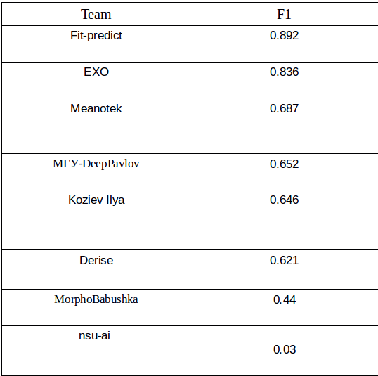
RESULTS

Slide 13
DISCUSSION
Need to extend system desing with new format converstion tools, to assist conversion from/to various data format types, since this seems to be main failure mode now
Interesting that character-level models can form representations that are useful for representing long-distance relations
Overall, results are sensible, given the time constraint

Slide 14
NOTES ON COMPETITIONS ORGANIZATION
Automatic scoring during competition would be nice to have
Standartization of formats and eval scripts
Clear and consistent policy on after-deadline submissions

Slide 15
THANK YOU FOR YOUR ATTENTION

Slide 16
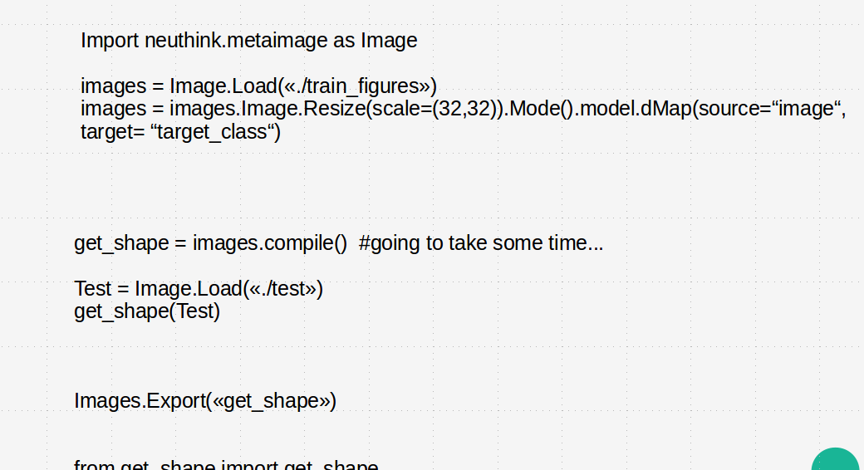
APPENDIX 1. How NeuThink differential programming model works

