Slide 1
BERT finetuning and graph modeling for gapping resolution
Belkin Ilya
ilya.belkin-trade@yandex.ru https://github.com/ivbelkin
Moscow Institute of Physics and Technology
2019

Slide 2
Agenda
Problem standing
Model architecture
Problems
Graph modeling
Use of additional data
Mistakes
Results

Slide 3
Problem standing
Binary presence-absence classification = sentence level classification
Gap resolution + Full annotation = sequence tagging
Tags only for cV, cR1, cR2, R1, R2
V always is start of correspondent R2
class | cV | cR1 | cR2 | V | R1 | R2
1 | 166:170 | 171:190 | 191:206 | 222:222 254:254 | 208:219 240:251 | 222:237 254:269

Slide 4
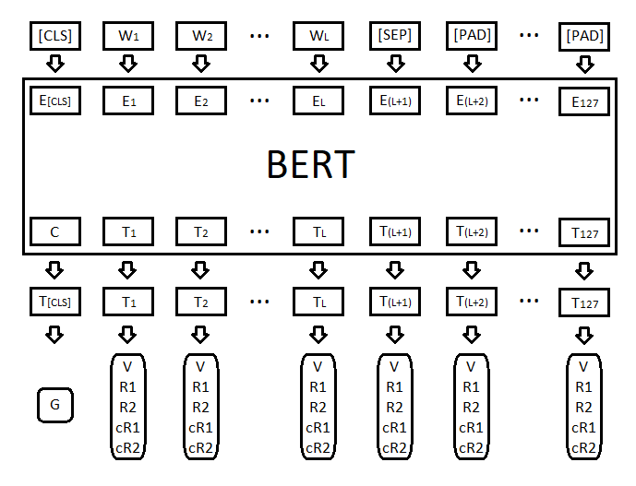
Model architecture
BERT - language model, new SOTA in 11 NLP tasks
Context-dependent word embeddings
12-layer, 768-hidden, 12-heads, 110M parameters
Songle model, 104 languages
Raw text, WordPiece tokenization
Pretrained weights by Google

Slide 5
Problems
Number of V, R1, R2 are equal
Order of tags is fixed
If cR2 is presented, then R2 must be presented too
If class == 1, then at least cV, cR1, V, R1 must be found.
class | cV | cR1 | cR2 | V | R1 | R2
1 | 166:170 | 171:190 | 191:206 | 222:222 254:254 | 208:219 240:251 | 222:237 254:269

Slide 6
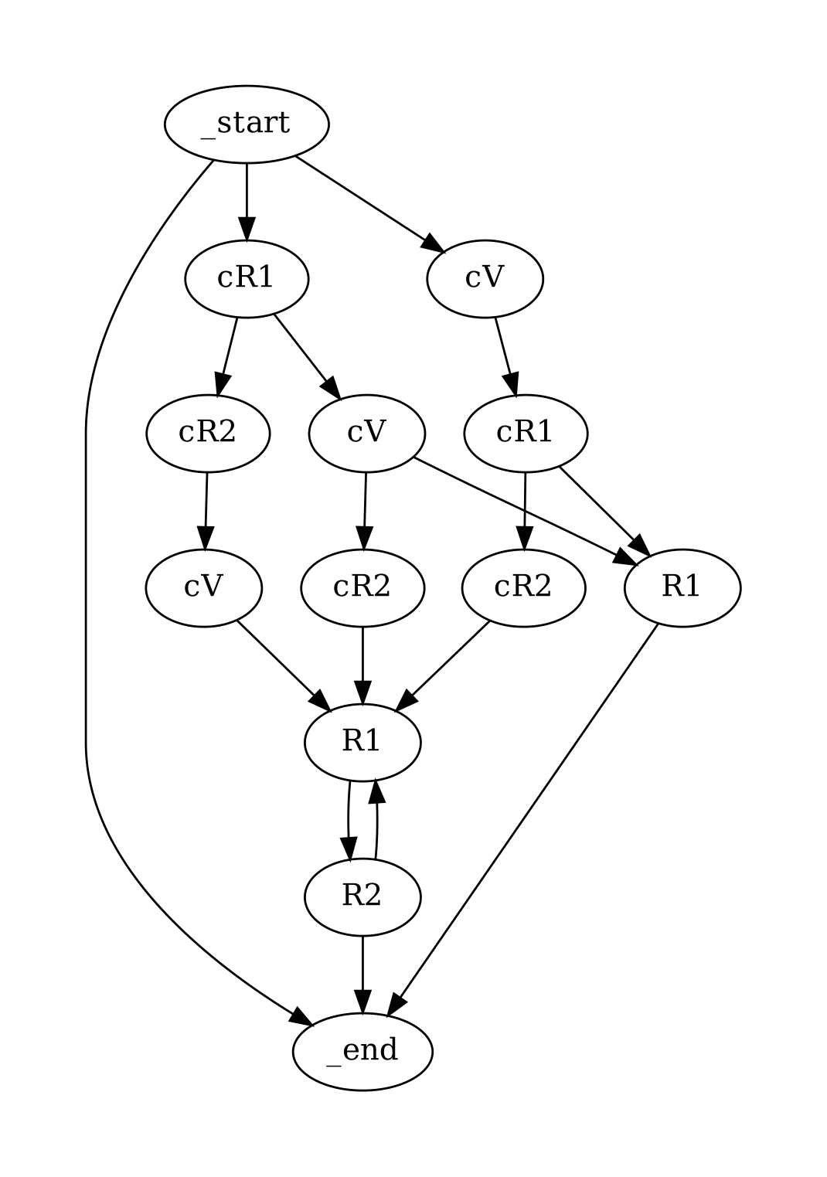
Graph modeling
Output distribution -> distribution over paths in graph
Challange: find most likely path of fixed length
Modification of Dijkstra algorithm

Slide 7
Use of additional data
Train set ~ 16K, Dev set ~ 4K sentences manualy annotated sentences
Add set ~ 115K sentences automatically annotated sentences
Add* = filtered by ensemble of models Add set
Train + Add* ~ 126K
Gives ~ 2% boost on Dev set

Slide 8
Mistakes
False negatives:
В жестах - нет песен, в музыке - ритма.
За 15 лет добросовестной службы в МЧС всё стало родным и все родными.
False positives:
Но к тому времени Джек был влюблен в Синди Пейдж, сейчас – миссис Джек Свайтек.
Раздался вой, а потом удаляющийся топот.

Slide 9
Results
 | Binary classification quality | Gapping resolution quality
Train + Add | 0.9988 | 0.9895
Train | 0.9973 | 0.9784
Dev | 0.9778 | 0.9313
Test | 0.9590 | 0.8901

Slide 10
Related links
Jacob Devlin, Ming-Wei Chang, Kenton Lee, Kristina Toutanova (2018) BERT: Pre-training of Deep Bidirectional Transformers for Language Understanding, available at https://arxiv.org/abs/1810.04805
Language models: https://github.com/huggingface/pytorch-pretrained-BERT
Repository with solution: https://github.com/ivbelkin/AGRR_2019

