Slide 1
Discovering dialectal differences based on oral corpora
Andriyanets Vasilisa, Michael Daniel, Brigitte Packendorf
Dialog 31.05.2018

Slide 2
Even
North Tungusic language spoken in Siberia and the Russian Far East
dialectally diverse (13 dialects and up to 24 sub-dialects)
Lamunkhin dialect still viable, contact with Sakha
Bystraja dialect is undergoing a shift to Russian
Notes:
increase font size, here and below where possible

Slide 3
Data
Lamunkhin Even and Bystraja Even
several field trips between 2007 and 2015
Lamunkhin: ~50,000 tokens, 37 speakers
Bystraja: ~34,000 tokens, 26 speakers

Slide 4
Goal
in many cases categorical differences come from differences in frequencies
detecting significant quantitative differences between the dialects using small corpora of oral narratives
we assume that quantitative difference deserves a qualitative explanation
Notes:
to be inserted yet?
in many cases categorical differences come from differences in frequencies and that’s some kind of justification
categ come from freq changes therefore we investigate freq diffs and for a later stage we think that

Slide 5
First Attempts
Log-Likelihood
showed high values for several morphemes, e.g.
Suffix | Observed, Lamunkhin | Observed, Bystraja | Expected, Lamunkhin | Expected, Bystraja | LL
Simultaneity converb -nikEn | 1083 | 59 | 688.72 | 453.28 | 739.84
Locative (nouns) -(Du)LE | 966 | 503 | 885.93 | 583.07 | 18.56
Notes:
locative

Slide 6
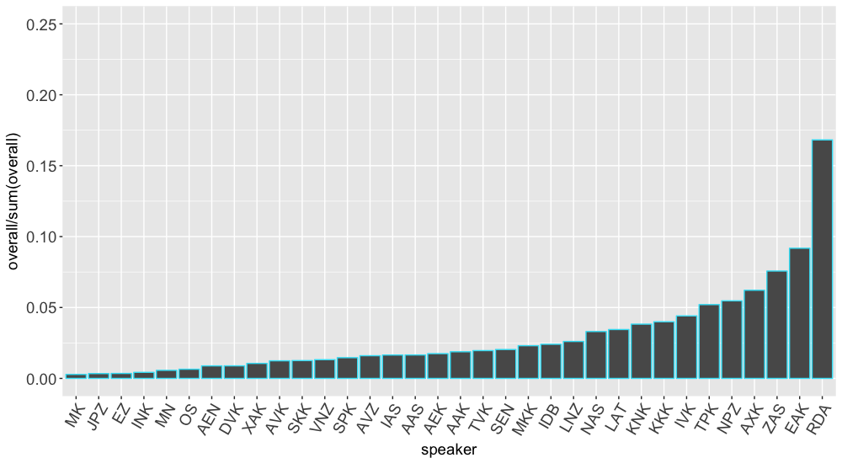
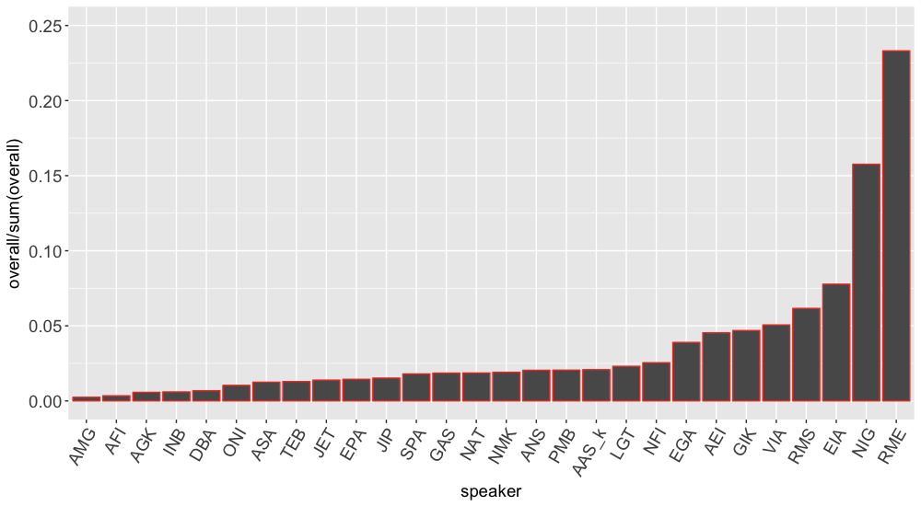
Problem
What is significance and what is effect size?
In this approach we can’t be sure whether it is dialectal or speaker-based difference (cf. the charts)
Notes:
MD: I would make it more explicit on the slide that these are two different points, and the charts are only illustrative of the second. Something like a. … b. … (cf. the charts)
and we can’t just throw away overrepresented speakers, remember the corpus size
when significant when ~ 18?

Slide 7
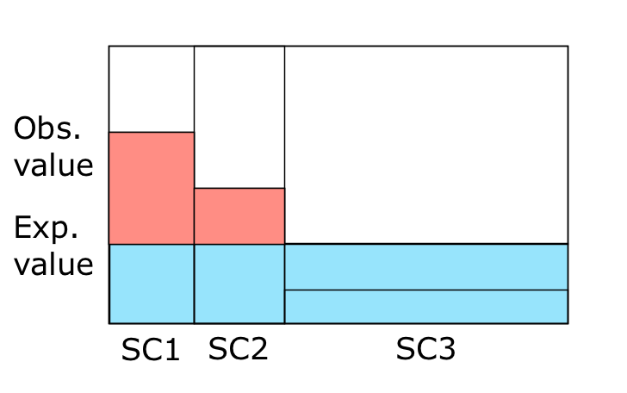
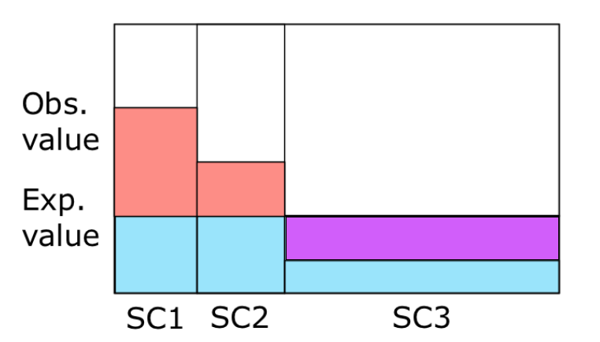
DP
DP = sum(abs(exp-obs))/2
Notes:
MD: cool! but paint the upper part of SC3 into something other than blue - either red or maybe another shade of red/pink, to show that here it is the deficit, not proficit

Slide 8
Application of DP
DP on subcorpora of speakers inside the two corpora
If the DP value inside the corpus < 0.2 => fairly evenly distributed
If even distribution in both corpora => we can trust LL
What if not?
Suffix | DP Lamunkhin | DP Bystraja | Log-likelihood
locative (nouns) -(Du)LE | 0.085 | 0.098 | 18.56
simultaneity converb -nikEn | 0.139 | 0.294 | 739.84
Notes:
Suggest to change to - What if not?

Slide 9
Problem
DP values are hard to interpret:
no significance thresholds!
Notes:
MD: I think, this is one and the same problem - not two lines. If in two lines, one tries to see this as two different problems (and fails)

Slide 10
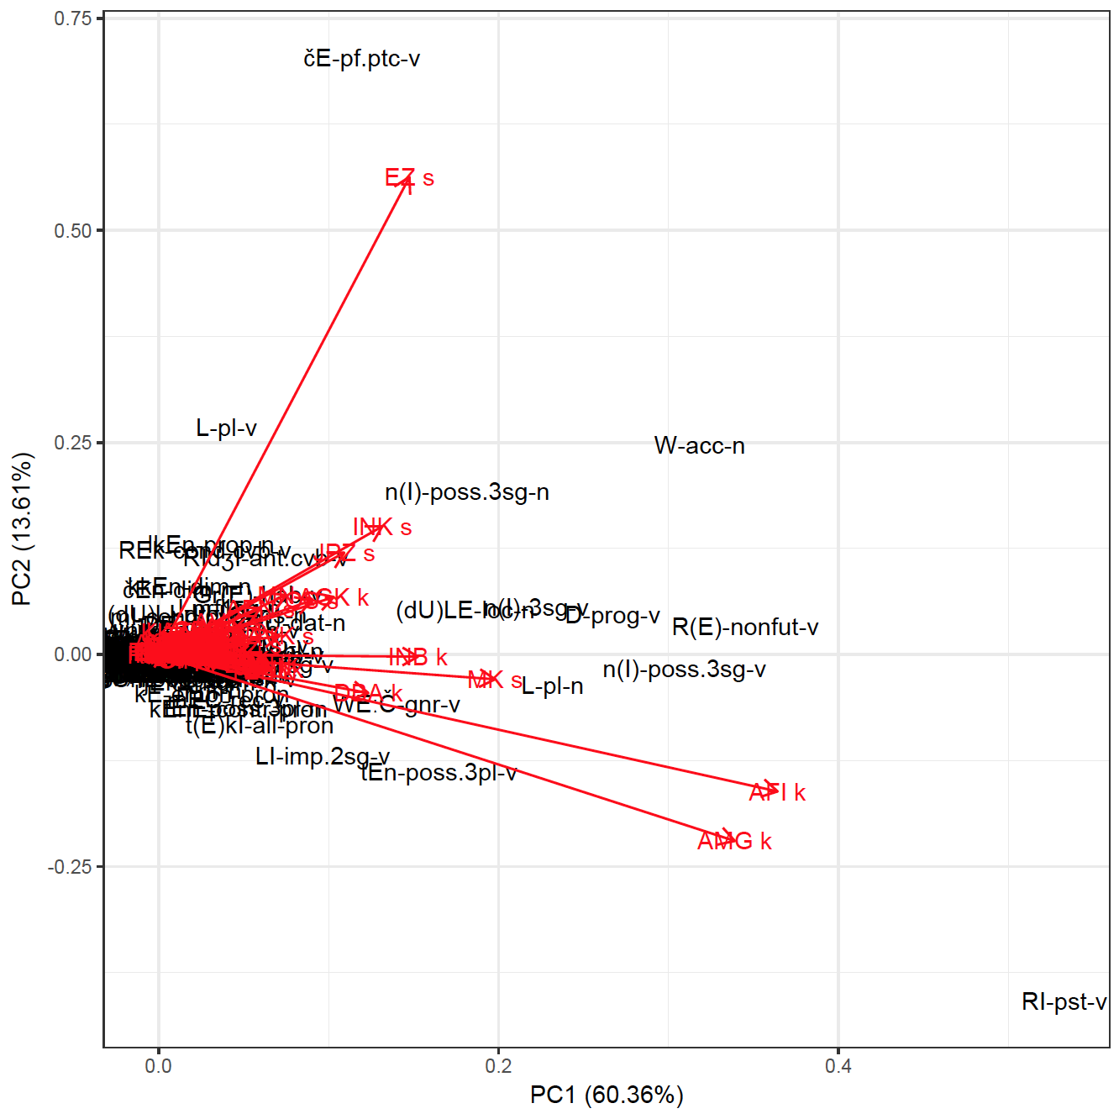
PCA

Slide 11
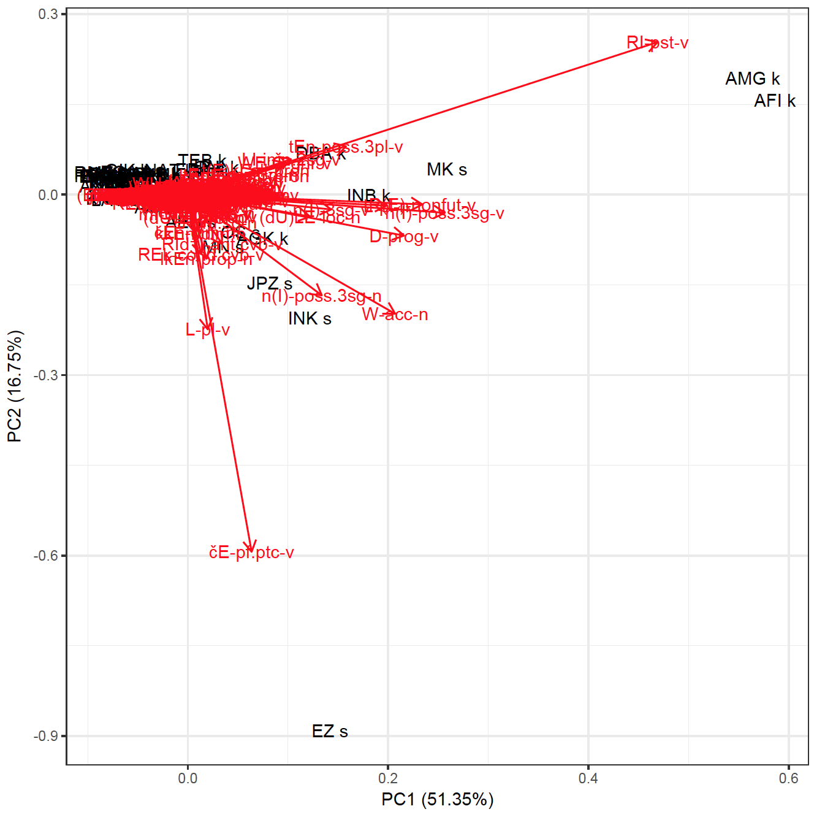
PCA
Notes:
MD: I am not sure in what sense it is not a solution of threshold problem. In a sense, for PCA, a substitute for significance is the percent of dispersion explained by the model. ANd it is pretty high in our case. So if you guys know how to interpret the model, it’s ok)))
here, the axes are speakers and dots are morphemes
but still no indication of the speaker’s impact
it’s not the high contributors that are outliers
still not a solution for DP no-threshold problem
and suffixes are different not the ones we are interested in are driving the difference

Slide 12
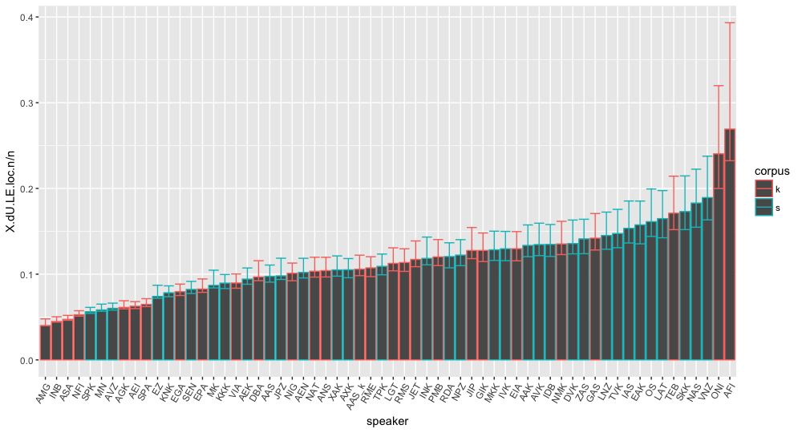
Notes:
suppose that we build a barplot with speaker frequencies for a given morpheme. Then we should consider the two groups on this slide badly separated

Slide 13
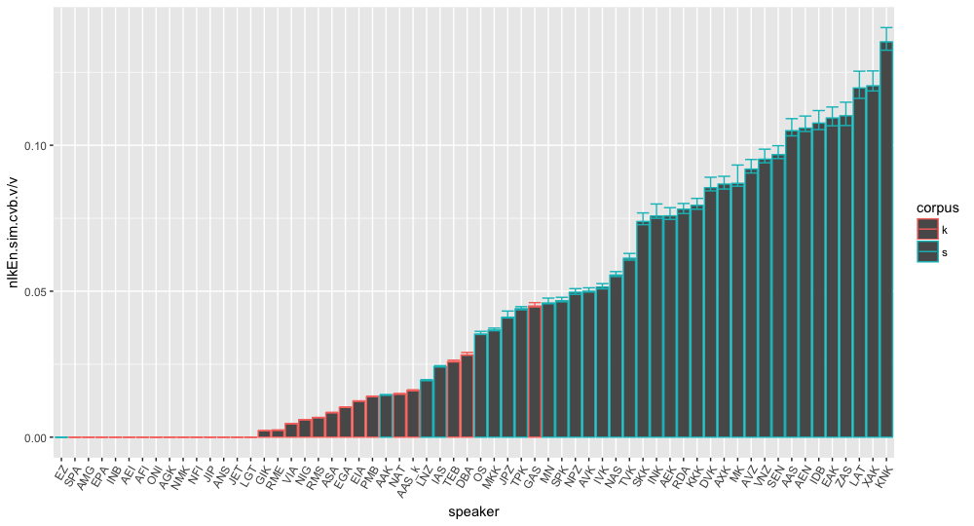
Notes:
MD: better: almost perfectly
and the two groups on this slide perfectly separated

Slide 14
Wilcoxon (Mann-Whitney) rank sum test
count frequency not in the whole corpus but among eligible morphemes
data: (dU)LE.loc.n/n by corpus W = 364, p-value = 0.1152
data: nIkEn.sim.cvb.v/v by corpus W = 36, p-value = 3.825e-10
Notes:
MD: non-parametrical test which is a measure for the degree of случайности (hell knows how to tgranslate it here, there is probably no such word as incidentality) of ranking
MD: what does it mean that MW gives a significant result for the locative which does not seem to be well separated?
called differently in different domains
it calculates the probability of the two samples being from the same population
решение проблемы statistical significance

Slide 15
Adjustment
count frequency of nominal suffixes among nominals, not all words
the results can be different
which analysis do we trust and what does the difference tell us?
data: (dU)LE.loc.n/overall by corpus W = 297, p-value = 0.01086
data: (dU)LE.loc.n/n by corpus W = 364, p-value = 0.1152
Notes:
MD: Whoa, indeed! which analysis do we trust here? keine ahnung, need to discuss this at some point. I cannot yet imagine why the two counts give the results that are so different. Vasilisa, I think we need to look also at the bar charts as above but built with respect to nouns, not the corpus, as we calculated MW here.
MD: Vasilisa, can you add to this slide a similar comparison of two ways of counting for the simultaneity converb? is statistical significance also lost when you count against verbs?
MD: count frequency not in the whole corpus but among eligible morphemes (seems to be more precise); for instance. locatives against the total number of nominals or converbs against the total number of verbs

Slide 16
Comparing models
Log-Likelihood
no clear significance thresholds
does not account for uneven contribution from different speakers
DP
indicates uneven contribution from different speakers
no clear significance thresholds
PCA
allows to check for outliers
does not account for different speakers’ impact
Wilcoxon test
clear significance estimates
does not account for uneven contribution from different speakers
(but does not seem to be overly sensitive to this)
Notes:
to sum up

Slide 17
Comparing models
PCA
allows to check for outliers
does not account for different speakers’ impact
Wilcoxon test
clear significance estimates
does not account for uneven contribution from different speakers
(but does not seem to be over-sensitive to this)
Notes:
MD: can’t we put the comparison of the four models together?
W gives p-values does not directly take into account different inputs from different speakers

Slide 18
Conclusion
One needs to keep in mind different input from different speakers
Some models (whether they do account for different input) provide results that are hard to interpret (LL, DP)
Still looking for an ideal model
Notes:
MD: The conclusions need to be put better: One need to keep in mind different input from different speakers. Some models (whether they do account for different input) provide results that are hard to interpret (LL, DP). MW results are not very clear (why does significance go away when we count against eligible morphemes). We are still looking for a model that would satisfy us.
the question stands still, and the ideal model would incorporate all of the features we need including speaker impact.

